Slide 1
“Though not a prostitute, she is sexually immoral…”
“…the woman’s life has been markedly immoral…”
“Jesus’ bidding her to call her husband is really a call to confess her sins…”
“…his obvious wish to reform her life…”

Slide 2
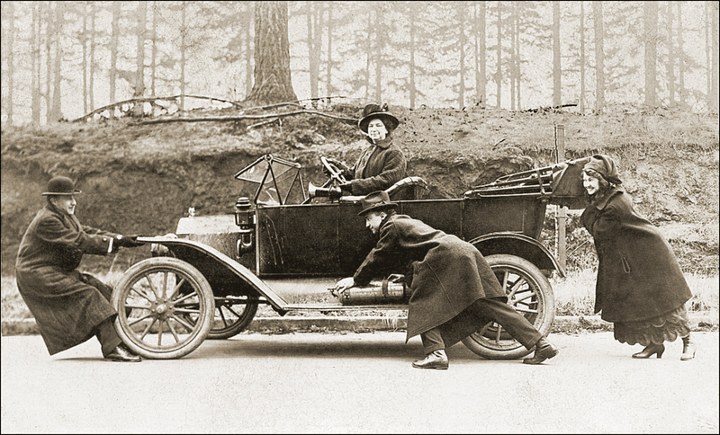
© 2017 www.clipart.com. Used by permission.

Slide 3
“Clearly they were good people, they had a desire to help people in need. Perhaps they were living out their faith.”
Internal explanation: behavior was caused by an internal character quality.
“There was no one else around to help and the car was in a dangerous position, so clearly they had to stop and help.”
Contextual explanation: behavior was caused by factors in the surrounding context.

Slide 4
“Though not a prostitute, she is sexually immoral…”
“…the woman’s life has been markedly immoral…”
“Jesus’ bidding her to call her husband is really a call to confess her sins…”
“…his obvious wish to reform her life…”

Slide 5
The woman would have had no choice about whether, or whom, to marry.
She has been used and abandoned by five men.
She is deeply shamed in her community, and so is alone at the well.
Because of her shame, she cannot go to the places of public worship.
She does not have to be at a temple to worship;
God can meet (and has met) her where she is.
Paraphrases for this slide drawn from In the Land of Blue Burqas by Kate McCord, Moody Publishers, 2012. Used by permission of Moody Publishers.

